Slide 1

Elementary Statistics
Thirteenth Edition
Chapter 7
Estimating Parameters and Determining Sample Sizes
Copyright © 2018, 2014, 2012 Pearson Education, Inc. All Rights Reserved

Slide 2
Estimating Parameters and Determining Sample Sizes
7−1 Estimating a Population Proportion
7−2 Estimating a Population Mean
7−3 Estimating a Population Standard Deviation or Variance
7−4 Bootstrapping: Using Technology for Estimates

Slide 3
Key Concept
This section presents methods for using a sample proportion to make an inference about the value of the corresponding population proportion. Here are the three main concepts included in this section:
Confidence Interval: We can use a sample proportion to construct a confidence interval estimate of the true value of a population proportion.
Sample Size: We should know how to find the sample size necessary to estimate a population proportion.

Slide 4
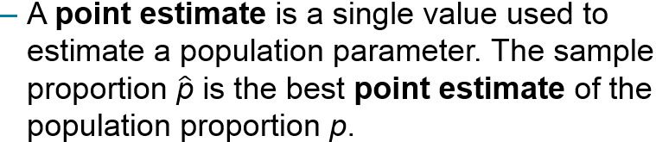
Point Estimate (1 of 2)
Point Estimate

Slide 5
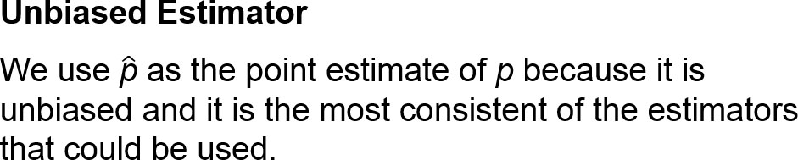
Point Estimate (2 of 2)
An unbiased estimator is a statistic that targets the value of the corresponding population parameter in the sense that the sampling distribution of the statistic has a mean that is equal to the corresponding population parameter.

Slide 6
Example: Facebook (1 of 2)
A Gallup poll was taken in which 1487 adults were surveyed and 43% of them said that they have a Facebook page. Based on that result, find the best point estimate of the proportion of all adults who have a Facebook page.

Slide 7
Example: Facebook (2 of 2)
Solution
Because the sample proportion is the best point estimate of the population proportion, we conclude that the best point estimate of p is 0.43. (If using the sample results to estimate the percentage of all adults who have a Facebook page, the best point estimate is 43%.)

Slide 8
Confidence Interval
Confidence Interval
A confidence interval (or interval estimate) is a range (or an interval) of values used to estimate the true value of a population parameter. A confidence interval is sometimes abbreviated as CI.

Slide 9
Confidence Level
Confidence Level
The confidence level is the probability 1 − α (such as 0.95, or 95%) that the confidence interval actually does contain the population parameter, assuming that the estimation process is repeated a large number of times. (The confidence level is also called the degree of confidence, or the confidence coefficient.)

Slide 10
Relationship Between Confidence Level and α
The following table shows the relationship between the confidence level and the corresponding value of α. The confidence level of 95% is the value used most often.
Most Common Confidence Levels | Corresponding Values of α
90% (or 0.90) confidence level: | α = 0.10
95% (or 0.95) confidence level: | α = 0.05
99% (or 0.99) confidence level: | α = 0.01

Slide 11
Interpreting a Confidence Interval (1 of 3)
We must be careful to interpret confidence intervals correctly. There is a correct interpretation and many different and creative incorrect interpretations of the confidence interval 0.405 < p < 0.455.
Correct: “We are 95% confident that the interval from 0.405 to 0.455 actually does contain the true value of the population proportion p.”

Slide 12
Interpreting a Confidence Interval (2 of 3)
We must be careful to interpret confidence intervals correctly. There is a correct interpretation and many different and creative incorrect interpretations of the confidence interval 0.405 < p < 0.455.
Wrong: “There is a 95% chance that the true value of p will fall between 0.405 and 0.455.”

Slide 13
Interpreting a Confidence Interval (3 of 3)
We must be careful to interpret confidence intervals correctly. There is a correct interpretation and many different and creative incorrect interpretations of the confidence interval 0.405 < p < 0.455.
Wrong: “95% of sample proportions will fall between 0.405 and 0.455.”

Slide 14
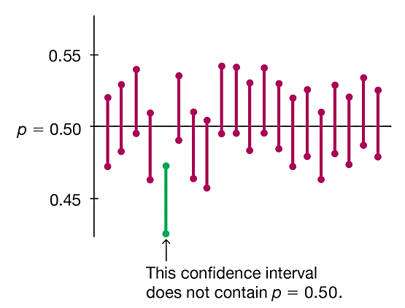
The Process Success Rate
A confidence level of 95% tells us that the process we are using should, in the long run, result in confidence interval limits that contain the true population proportion 95% of the time.
Confidence Interval from 20 Different Samples

Slide 15
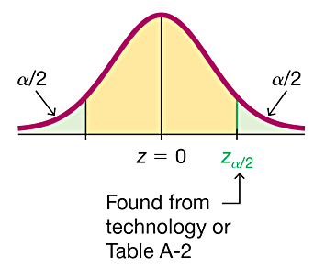
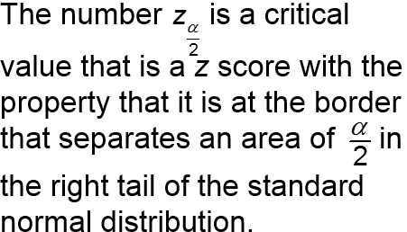
Critical Values
Critical Values
A critical value is the number on the borderline separating sample statistics that are significantly high or low from those that are not significant.

Slide 16

Example: Finding a Critical Value (1 of 3)

Slide 17
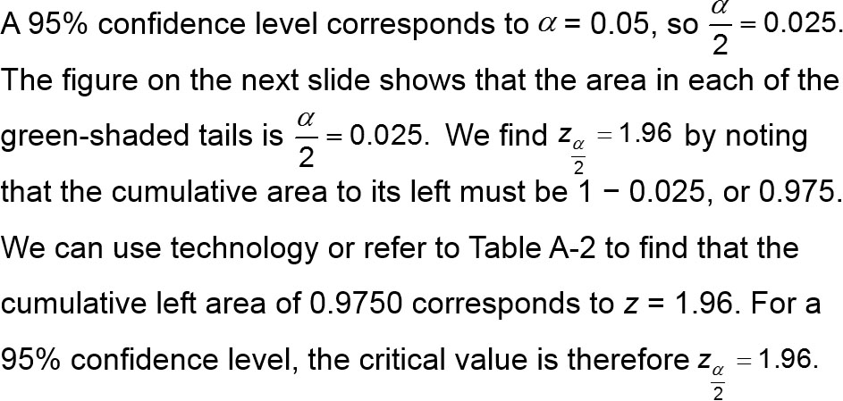
Example: Finding a Critical Value (2 of 3)
Solution

Slide 18
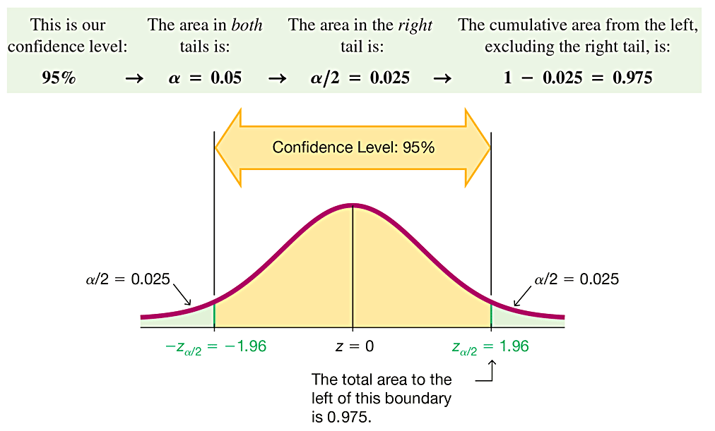
Example: Finding a Critical Value (3 of 3)
Note that when finding the critical z score for a 95% confidence level, we use a cumulative left area of 0.9750 (not 0.95). Think of it this way:

Slide 19
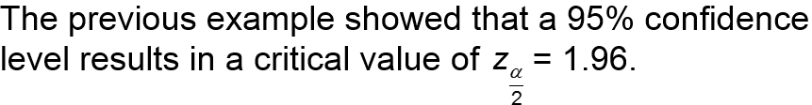
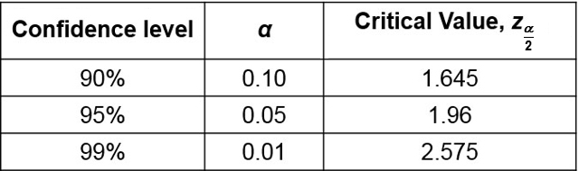
Common Critical Values
This is the most common critical value, and it is listed with two other common values in the table that follows.

Slide 20
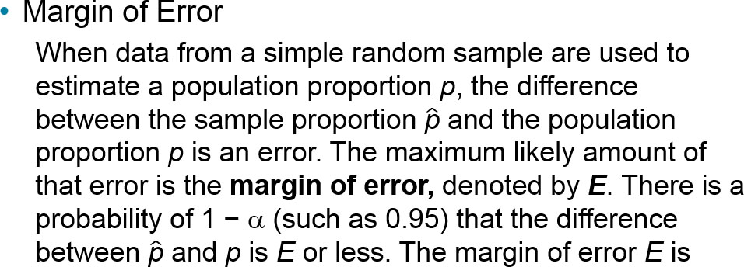
Margin of Error
The margin of error E is also called the maximum error of the estimate and can be found by multiplying the critical value and the estimated standard deviation of sample proportions.

Slide 21
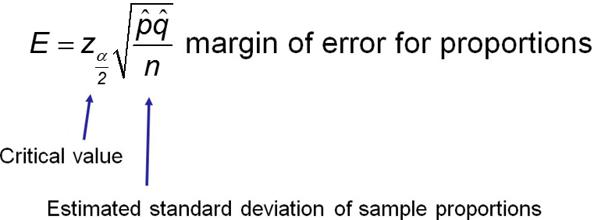
Margin of Error for Proportions
Formula

Slide 22
Confidence Interval for Estimating a Population Proportion p: Objective
Construct a confidence interval used to estimate a population proportion p.

Slide 23
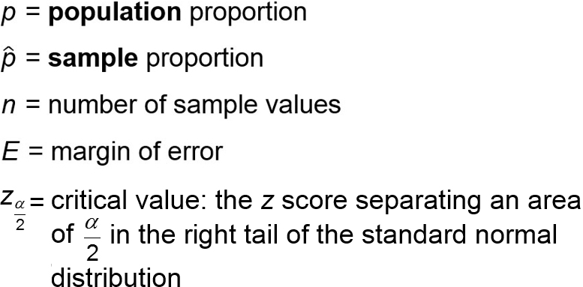
Confidence Interval for Estimating a Population Proportion p: Notation

Slide 24
Confidence Interval for Estimating a Population Proportion p: Requirements
The sample is a simple random sample.
The conditions for the binomial distribution are satisfied: There is a fixed number of trials, the trials are independent, there are two categories of outcomes, and the probabilities remain constant for each trial.
There are at least 5 successes and at least 5 failures.

Slide 25
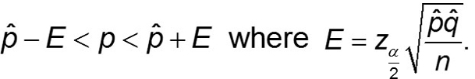

Confidence Interval for Estimating a Population Proportion p: Confidence Interval Estimate of p
The confidence interval is often expressed in the following formats:

Slide 26
Confidence Interval for Estimating a Population Proportion p: Round−Off Rule for Confidence Interval Estimates of p
Round the confidence interval limits for p to three significant digits.

Slide 27
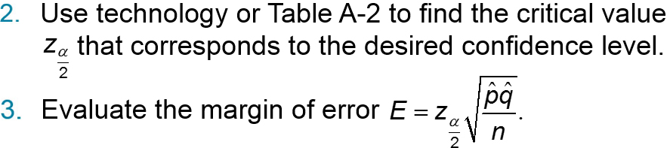
Procedure for Constructing a Confidence Interval for p (1 of 2)
Verify that the requirements in the preceding slides are satisfied.

Slide 28
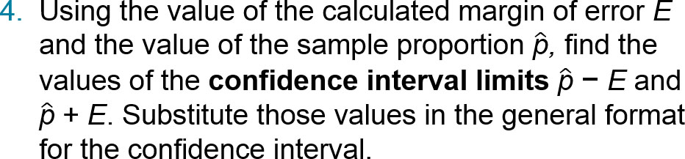
Procedure for Constructing a Confidence Interval for p (2 of 2)
Round the resulting confidence interval limits to three significant digits.

Slide 29
Example: Constructing a Confidence Interval: Poll Results (1 of 8)
We noted that a Gallup poll of 1487 adults showed that 43% of the respondents have Facebook pages.
Find the margin of error E that corresponds to a 95% confidence level.
Find the 95% confidence interval estimate of the population proportion p.
Based on the results, can we safely conclude that fewer than 50% of adults have Facebook pages? Assuming that you are a newspaper reporter, write a brief statement that accurately describes the results and includes all of the relevant information.

Slide 30
Example: Constructing a Confidence Interval: Poll Results (2 of 8)
Requirement Check
(1) The polling methods used by the Gallup organization result in samples that can be considered to be simple random samples.
(2) The conditions for a binomial experiment are satisfied because there is a fixed number of trials (1487), the trials are independent (because the response from one person doesn’t affect the probability of the response from another person), there are two categories of outcome (subject has a Facebook page or does not), and the probability remains constant, because P(having a Facebook page) is fixed for a given point in time.
(3) With 43% of the respondents having Facebook pages, the number with Facebook pages is 639 (or 43% of 1487). If 639 of the 1487 subjects have Facebook pages, the other 848 do not, so the number of successes (639) and the number of failures (848) are both at least 5.
The check of requirements has been successfully completed.

Slide 31
Example: Constructing a Confidence Interval: Poll Results (3 of 8)
Technology
The confidence interval and margin of error can be easily found using technology. From the Statdisk display on the next slide, we can see the required entries on the left and the results displayed on the right. Like most technologies, Statdisk requires a value for the number of successes, so we simply find 43% of 1487 and round the result of 639.41 to the whole number 639. The results show that the margin of error is E = 0.025 (rounded) and the confidence interval is 0.405 < p < 0.455 (rounded).

Slide 32
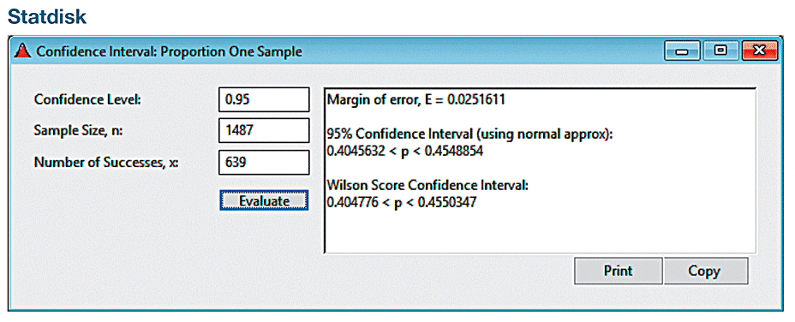
Example: Constructing a Confidence Interval: Poll Results (4 of 8)
Technology

Slide 33
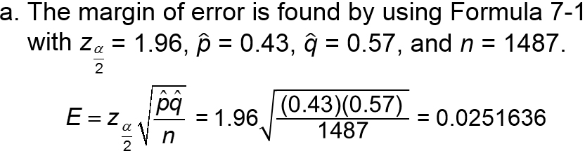
Example: Constructing a Confidence Interval: Poll Results (5 of 8)
Solution (Manual Calculation)

Slide 34
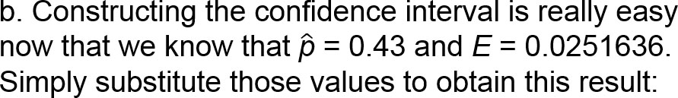

Example: Constructing a Confidence Interval: Poll Results (6 of 8)
Solution
0.43 − 0.0251636 < p < 0.43 + 0.0251636
0.405 < p < 0.455 (rounded)

Slide 35
Example: Constructing a Confidence Interval: Poll Results (7 of 8)
Solution
c. Based on the confidence interval obtained in part (b), it does appear that fewer than 50% of adults have a Facebook page because the interval of values from 0.405 to 0.455 is an interval that is completely below 0.50.

Slide 36
Example: Constructing a Confidence Interval: Poll Results (8 of 8)
Summary of results
Here is one statement that summarizes the results: 43% of adults have Facebook pages. That percentage is based on a Gallup poll of 1487 randomly selected adults in the United States. In theory, in 95% of such polls, the percentage should differ by no more than 2.5 percentage points in either direction from the percentage that would be found by interviewing all adults.

Slide 37
Analyzing Polls
When analyzing results from polls, consider the following:
The sample should be a simple random sample, not an inappropriate sample.
The confidence level should be provided.
The sample size should be provided.
Except for relatively rare cases, the quality of the poll results depends on the sampling method and the size of the sample, but the size of the population is usually not a factor.

Slide 38
Caution
Never think that poll results are unreliable if the sample size is a small percentage of the population size. The population size is usually not a factor in determining the reliability of a poll.

Slide 39
Finding the Point Estimate and E from a Confidence Interval
Point estimate of p:
Margin of error:

Slide 40
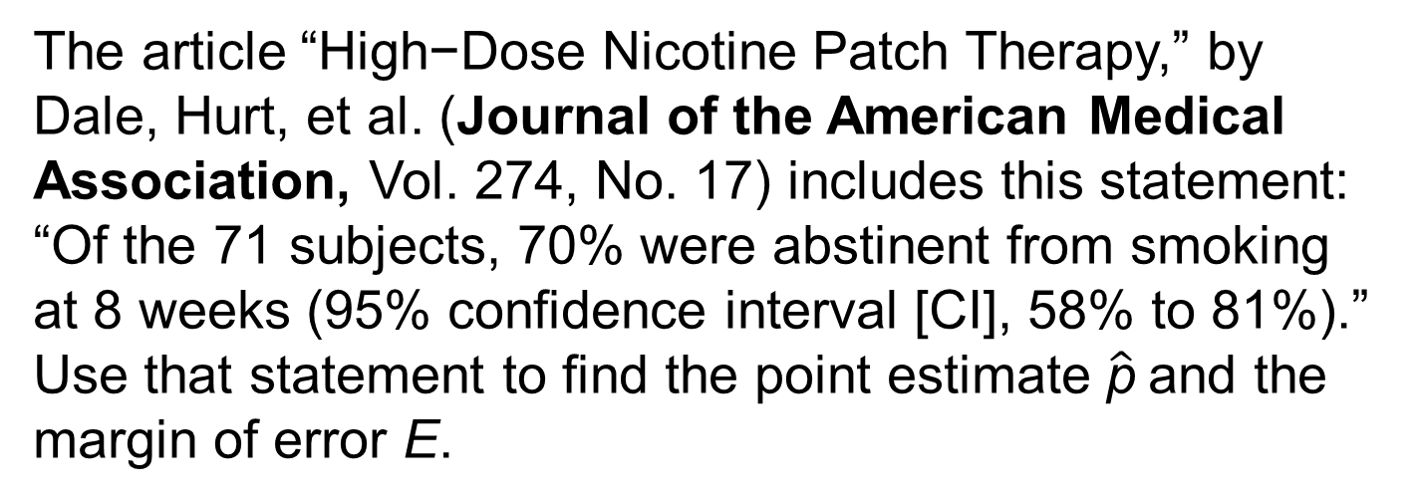
Example: Finding a Sample Proportion and Margin of Error (1 of 3)
The article “High−Dose Nicotine Patch Therapy,” by Dale, Hurt, et al. (Journal of the American Medical Association, Vol. 274, No. 17) includes this statement: “Of the 71 subjects, 70% were abstinent from smoking at 8 weeks (95% confidence interval [CI], 58% to 81%).” Use that statement to find the point estimate $\hat{\text{p}}$and the margin of error E.

Slide 41
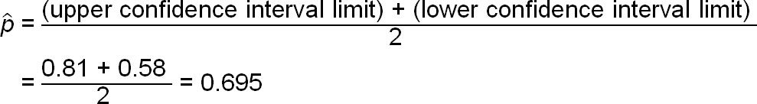
Example: Finding a Sample Proportion and Margin of Error (2 of 3)
Solution
We get the 95% confidence interval of 0.58 < p < 0.81 from the given statement of “58% to 81%.”

Slide 42

Example: Finding a Sample Proportion and Margin of Error (3 of 3)
Solution
The margin of error can be found as follows:

Slide 43
Determining Sample Size: Finding the Sample Size Required to Estimate a Population Proportion: Objective
Finding the Sample Size Required to Estimate a Population Proportion

Slide 44
Determining Sample Size: Finding the Sample Size Required to Estimate a Population Proportion: Notation

Slide 45
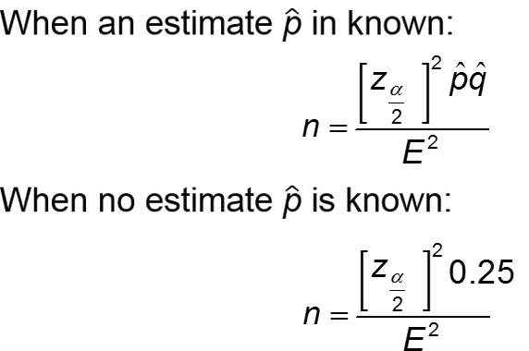
Determining Sample Size: Finding the Sample Size Required to Estimate a Population Proportion: Requirements
The sample must be a simple random sample of independent sample units.

Slide 46
Determining Sample Size: Finding the Sample Size Required to Estimate a Population Proportion: Round−Off Rule for Determining Sample Size
If the computed sample size n is not a whole number, round the value of n up to the next larger whole number, so the sample size is sufficient instead of being slightly insufficient. For example, round 1067.11 to 1068.

Slide 47
Example: What Percentage of Adults Make Online Purchases? (1 of 4)
When the author was conducting research for this chapter, he could find no information about the percentage of adults who make online purchases, yet that information is extremely important to online stores as well as brick and mortar stores. If the author were to conduct his own survey, how many adults must be surveyed in order to be 95% confident that the sample percentage is in error by no more than three percentage points?
a. Assume that a recent poll showed that 80% of adults make online purchases.
b. Assume that we have no prior information suggesting a possible value of the population proportion.

Slide 48
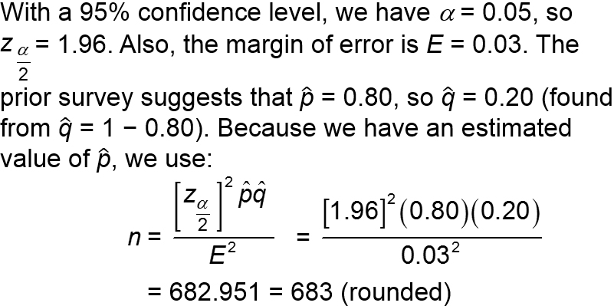
Example: What Percentage of Adults Make Online Purchases? (2 of 4)
Solution
a.
We must obtain a simple random sample that includes at least 683 adults.

Slide 49
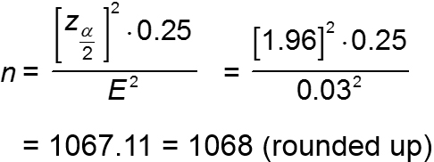
Example: What Percentage of Adults Make Online Purchases? (3 of 4)
Solution
With no prior knowledge of pn (or qn), we use Formula 7−3 as follows:
We must obtain a simple random sample that includes at least 1068 adults.

Slide 50
Example: What Percentage of Adults Make Online Purchases? (4 of 4)
Interpretation
To be 95% confident that our sample percentage is within three percentage points of the true percentage for all adults, we should obtain a simple random sample of 1068 adults, assuming no prior knowledge. By comparing this result to the sample size of 683 found in part (a), we can see that if we have no knowledge of a prior study, a larger sample is required to achieve the

Slide 51
Better Performing Confidence Intervals (1 of 3)
Plus Four Method
The plus four confidence interval performs better than the Wald confidence interval in the sense that its coverage probability is closer to the confidence level that is used.
The plus four confidence interval uses this very simple procedure: Add 2 to the number of successes x, add 2 to the number of failures (so that the number of trials n is increased by 4), and then find the Wald confidence interval as described in Part 1 of this section.

Slide 52
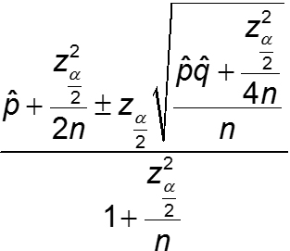
Better Performing Confidence Intervals (2 of 3)
Wilson Score
The Wilson score confidence interval performs better than the Wald CI in the sense that the coverage probability is closer to the confidence level. With a confidence level of 95%, the Wilson score confidence interval would get us closer to a 0.95 probability of containing the parameter p. However, given its complexity, it is easy to see why this superior Wilson score confidence interval is not used much in introductory statistics courses.

Slide 53
Better Performing Confidence Intervals (3 of 3)
Clopper−Pearson Method
The Clopper−Pearson method is an “exact” method in the sense that it is based on the exact binomial distribution instead of an approximation of a distribution. It is criticized for being too conservative in this sense: When we select a specific confidence level, the coverage probability is usually greater than or equal to the selected confidence level. Select a confidence level of 0.95, and the actual coverage probability is usually 0.95 or greater, so that 95% or more of such confidence intervals will contain p. Calculations with this method are too messy to consider here.

Slide 54
Which Method is Best?
There are other methods for constructing confidence intervals that are not discussed here. There isn’t universal agreement on which method is best for constructing a confidence interval estimate of p.
The Wald confidence interval is best as a teaching tool for introducing students to confidence intervals.
The plus four confidence interval is almost as easy as Wald and it performs better than Wald by having a coverage probability closer to the selected confidence level.

